Slide 1


Preparing the Data
SIT112 | Intro to Data Science & AI
Lecture Week 6

Slide 2
Objectives
Add datetime, string, and numeric columns that are derived from other columns to a DataFrame.
Add summary columns to a DataFrame.
Apply functions, user-defined functions, and lambda expressions to a DataFrame.
Set an index, unstack the data based on an index, and reset the index.
Join, merge, and concatenate DataFrames.
Fix any problems that are identified by the SettingWithCopyWarning.
Describe the appropriate uses for the join(), merge(), and concat() methods.
Describe an inner join.
Describe the SettingWithCopyWarning message and the type of problem that it may identify.

Slide 3
What is Data Preparation?
The process of transforming and organising raw data into a format suitable for analysis or machine learning algorithms.
A crucial step in the data science workflow because the quality of the data directly affects the accuracy and reliability of any insights or models derived from it.

Slide 4

How to Add and Modify Columns

Slide 5
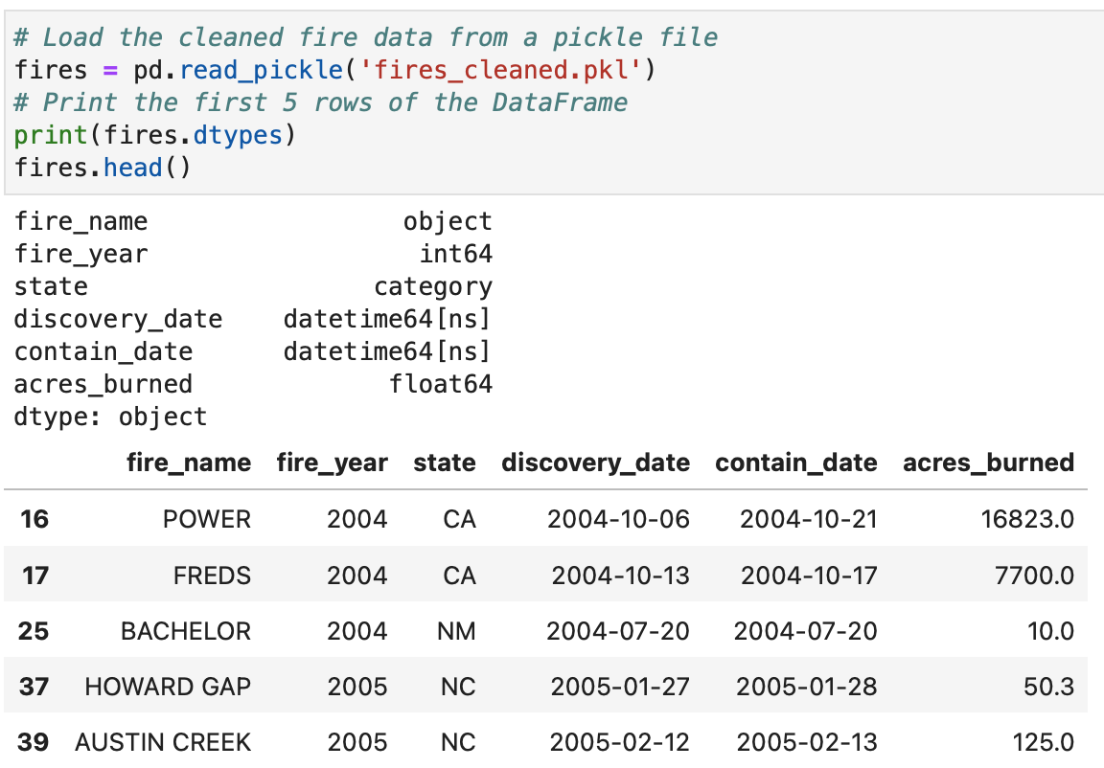
Working with the DateTime Columns

Slide 6
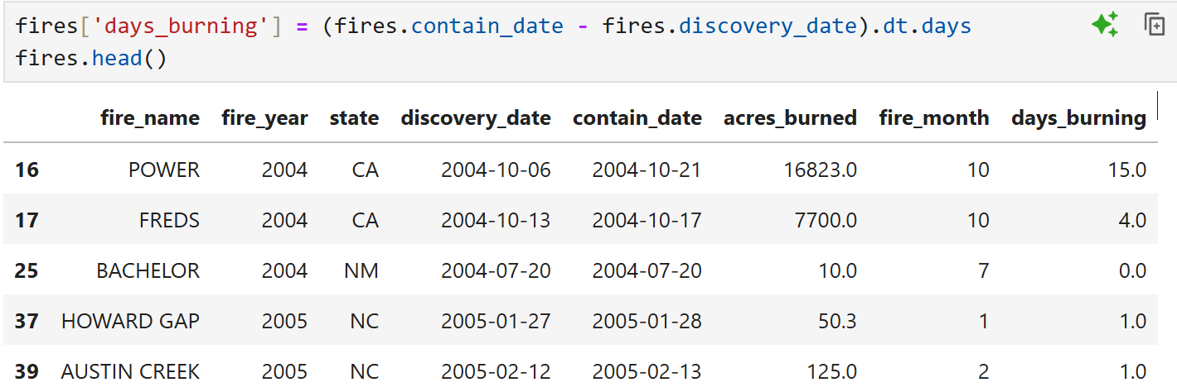
Working with the DateTime Columns (Cont.)

Slide 7
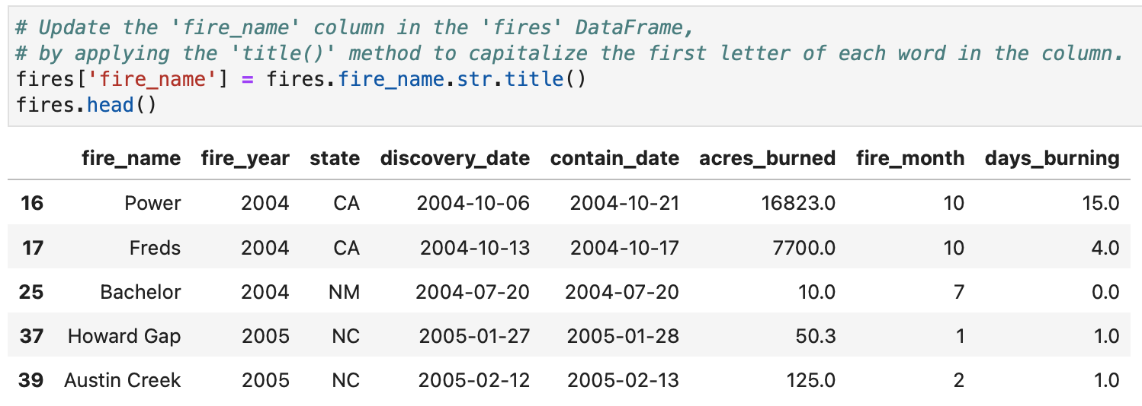
Working with String and Numeric Columns

Slide 8
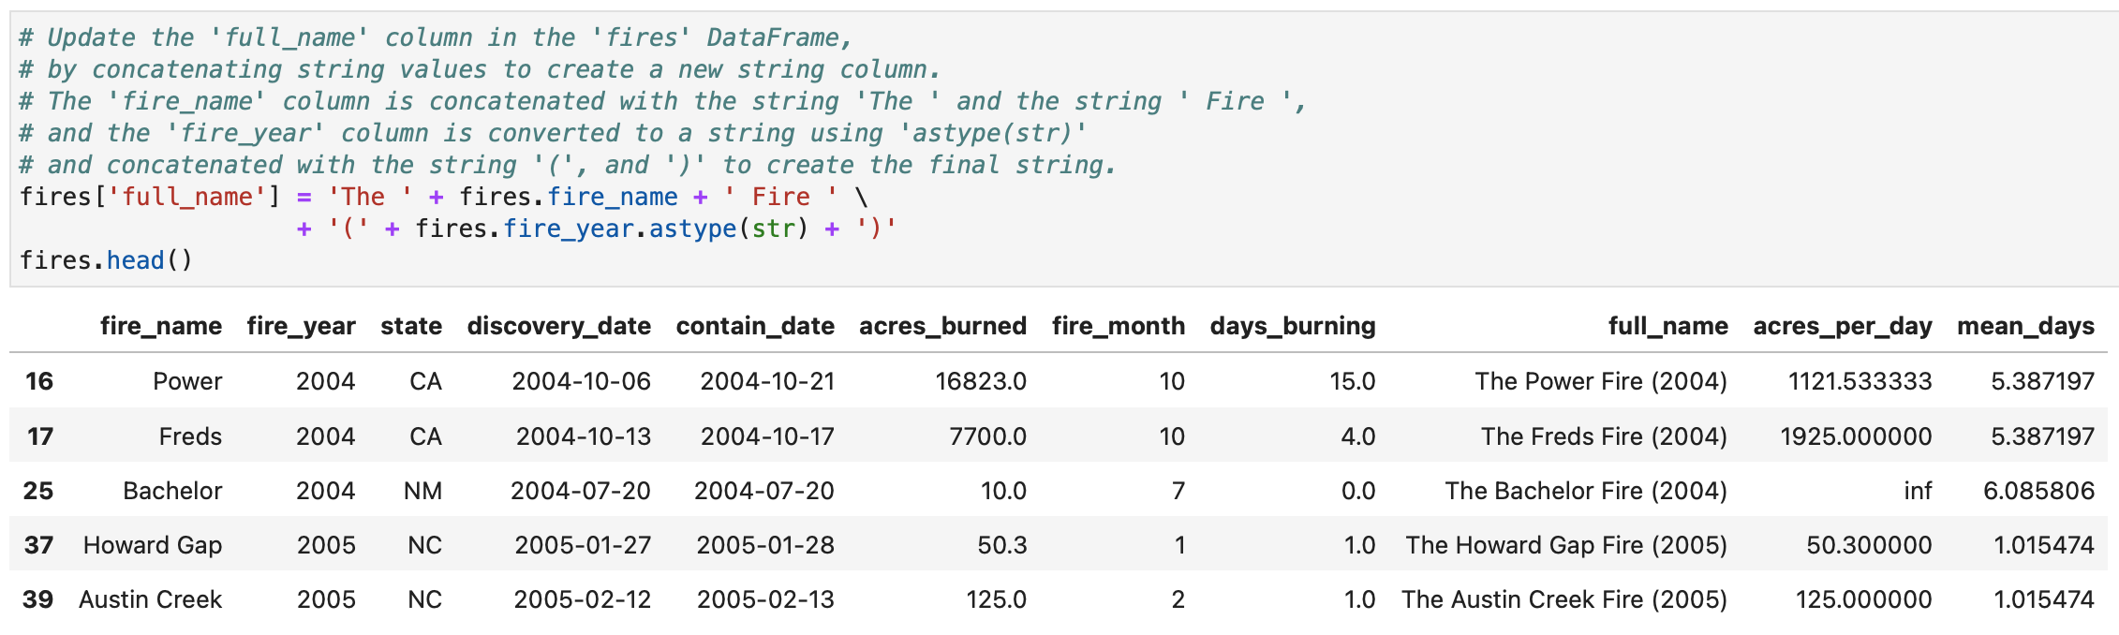
Working with String and Numeric Columns (Cont.)

Slide 9
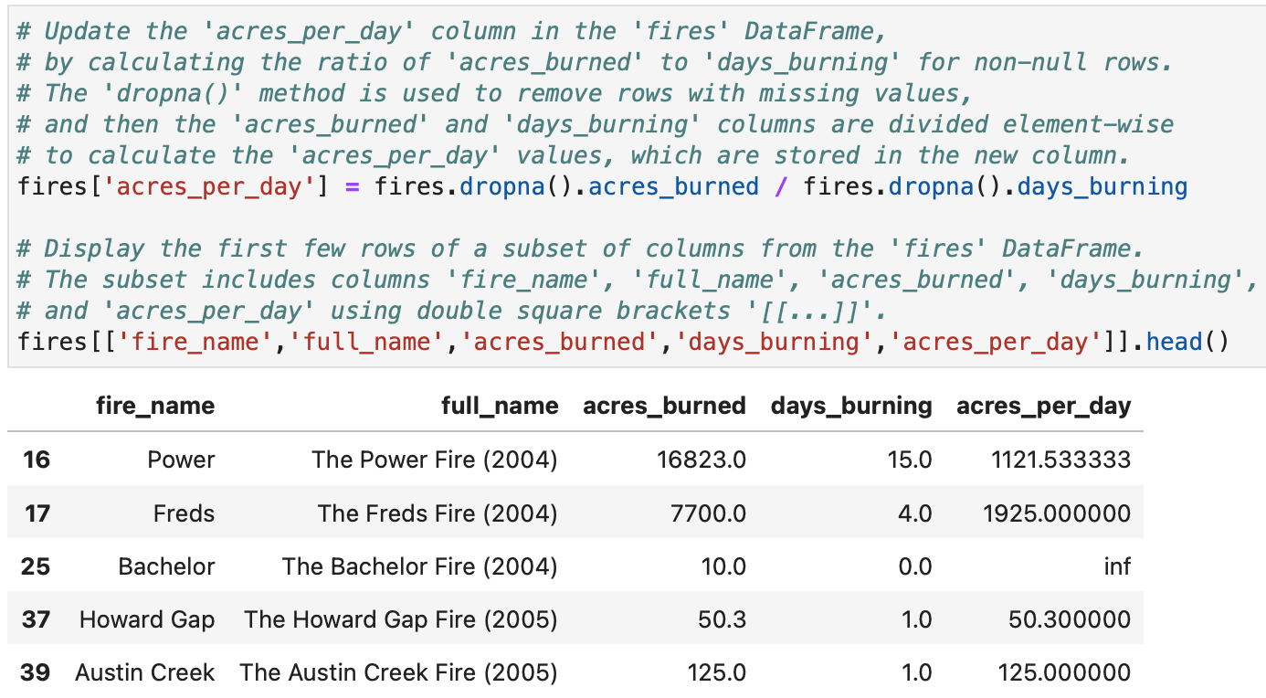
Working with String and Numeric Columns (Cont.)

Slide 10
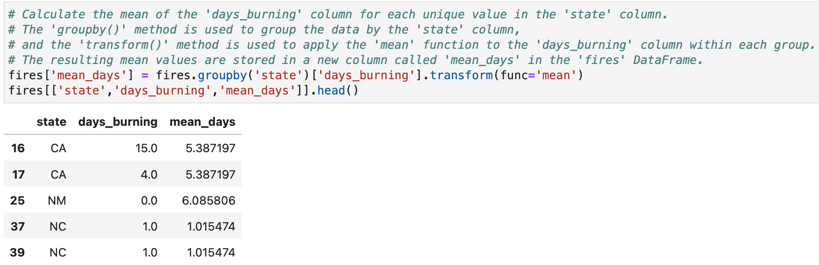
Adding a Summary Column

Slide 11
How to Apply Functions & Lambda Expressions

Slide 12
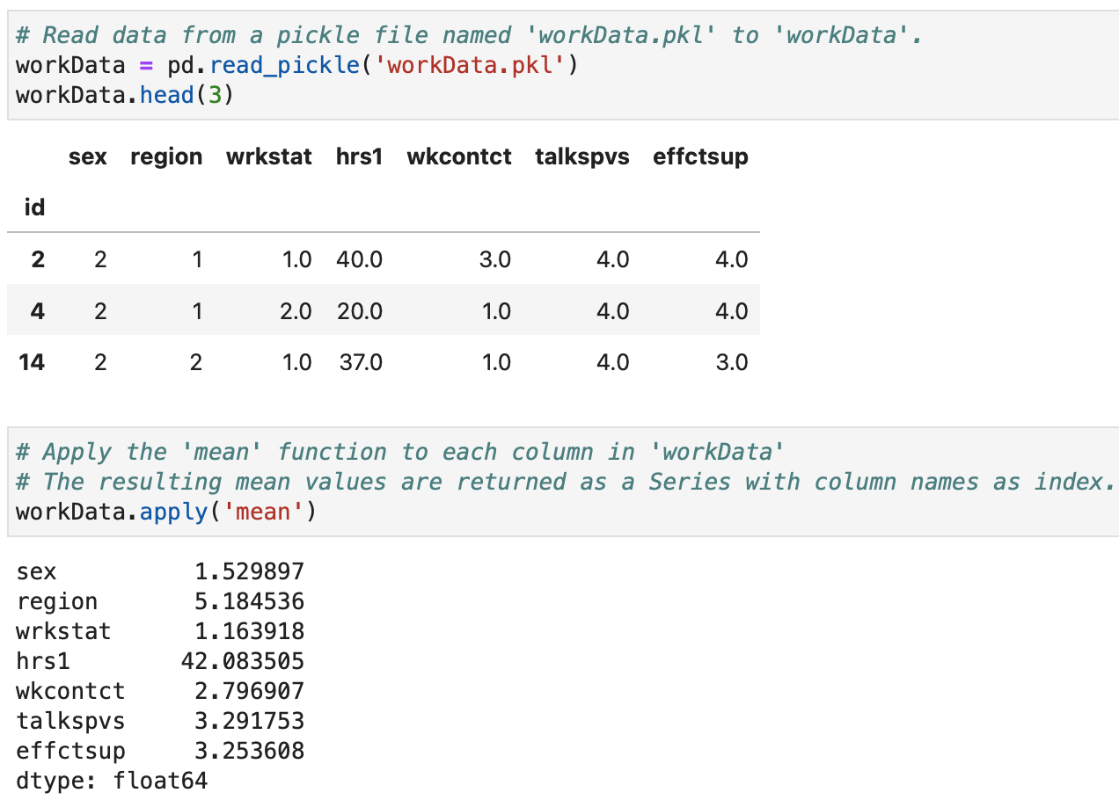
Applying Functions to Columns

Slide 13
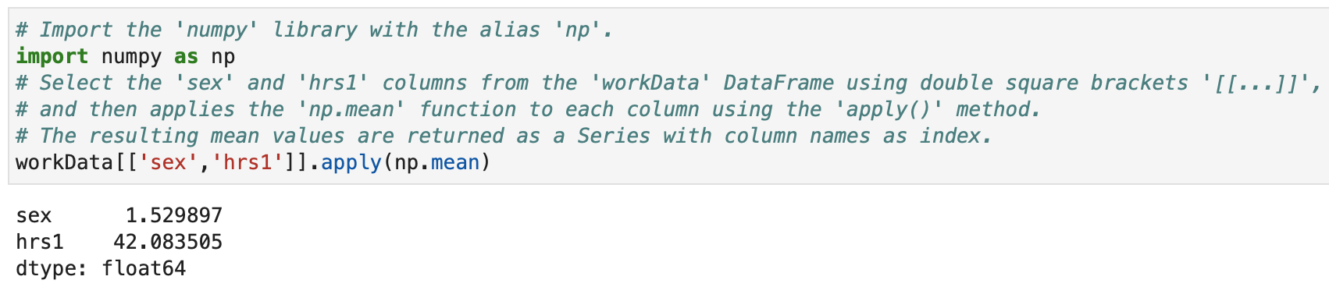
Applying Functions to Columns (Cont.)

Slide 14
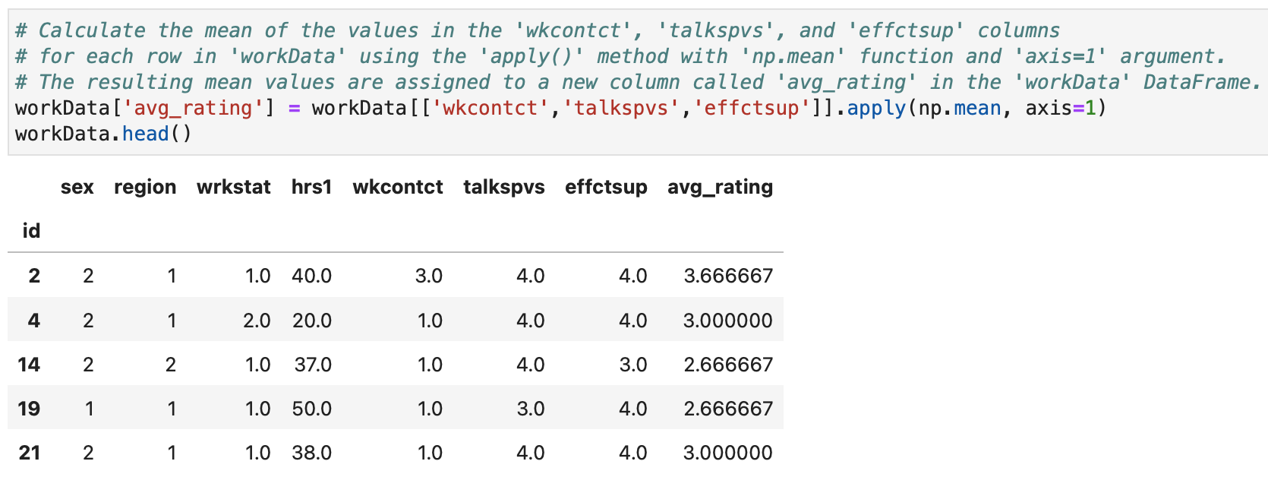
Applying Functions to Rows

Slide 15
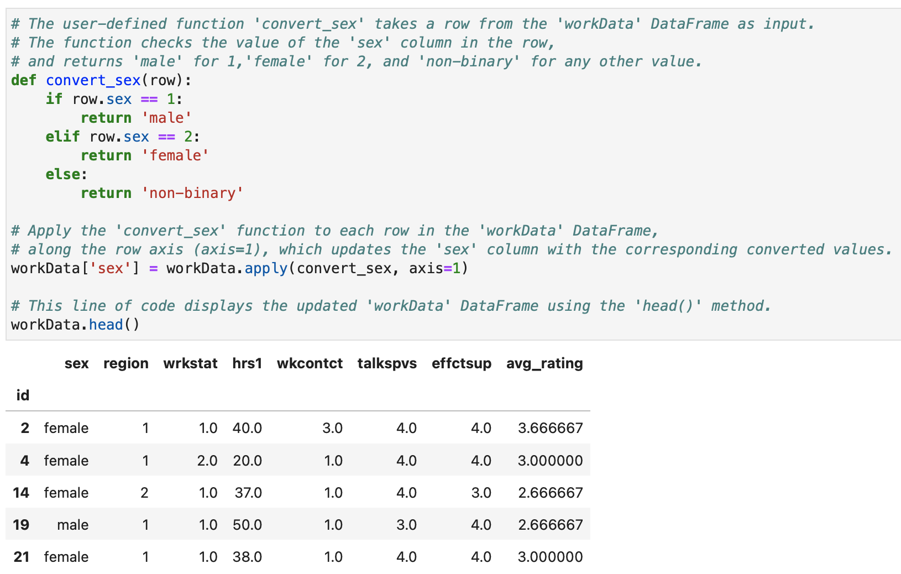
Applying User-Defined Functions

Slide 16
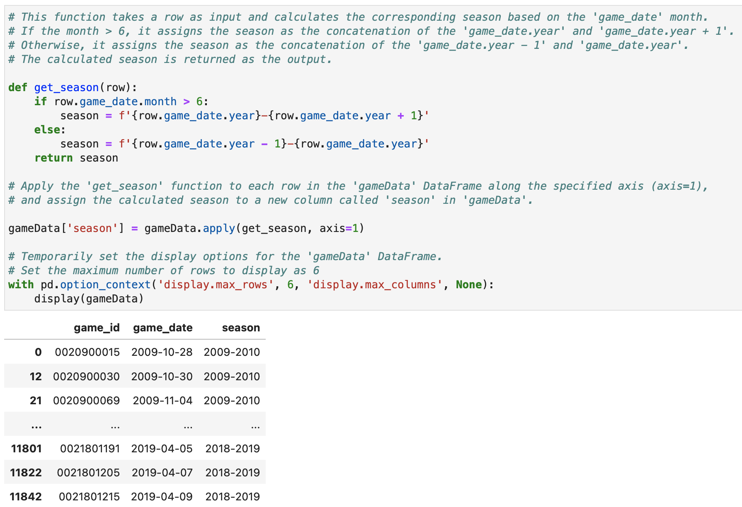
Applying User-Defined Functions (Cont.)

Slide 17
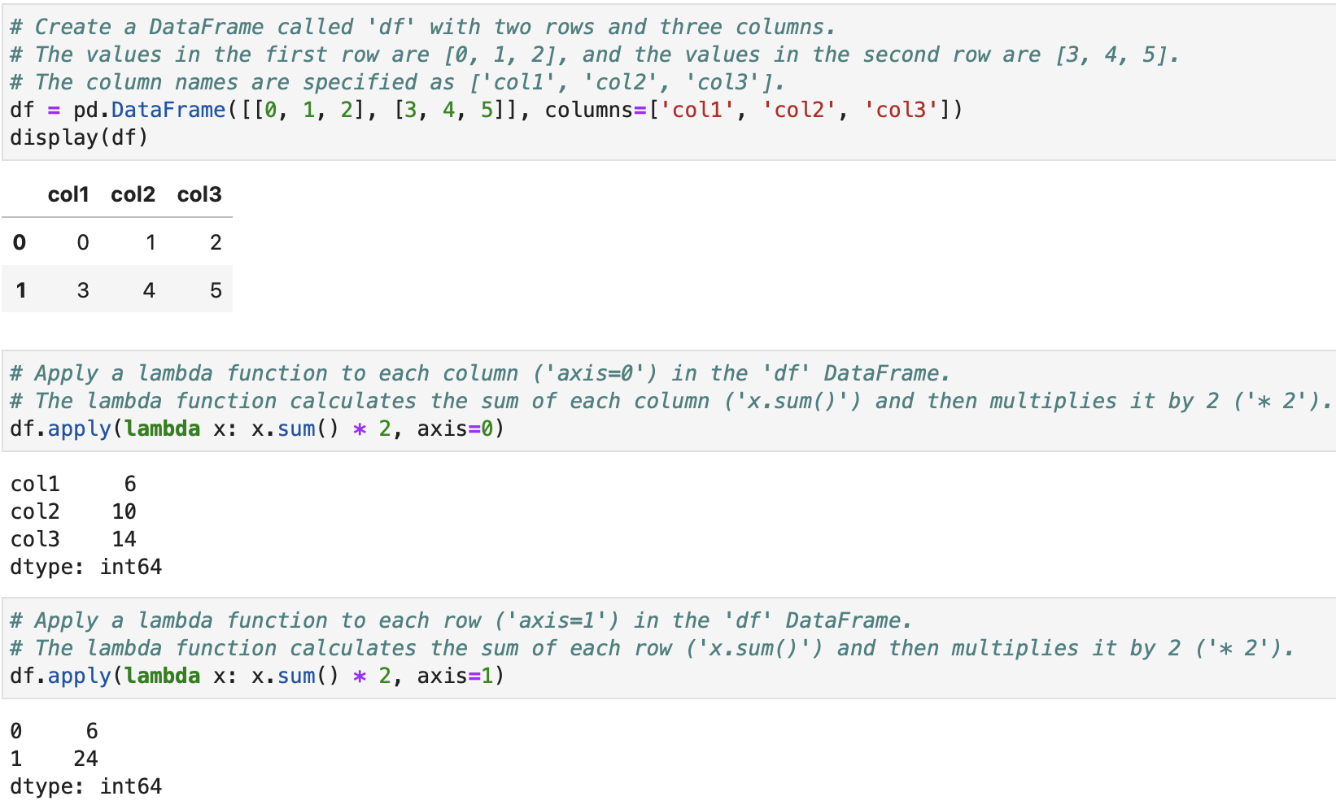
Lambda Expressions

Slide 18
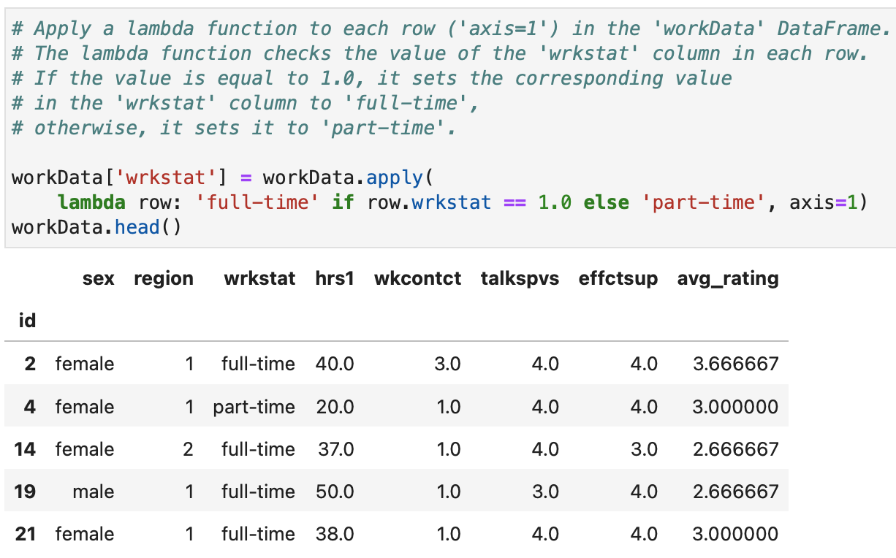
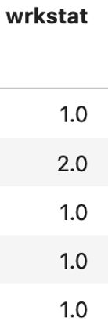
Lambda Expressions (Cont.)

Slide 19
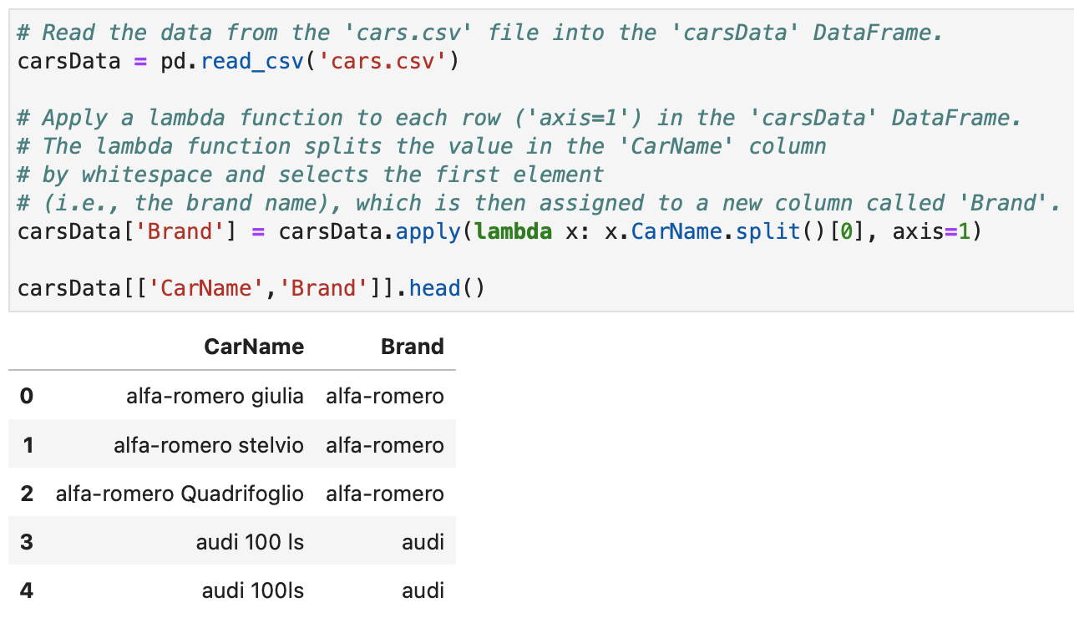
Lambda Expressions (Cont.)

Slide 20
How to Work with Indexes

Slide 21
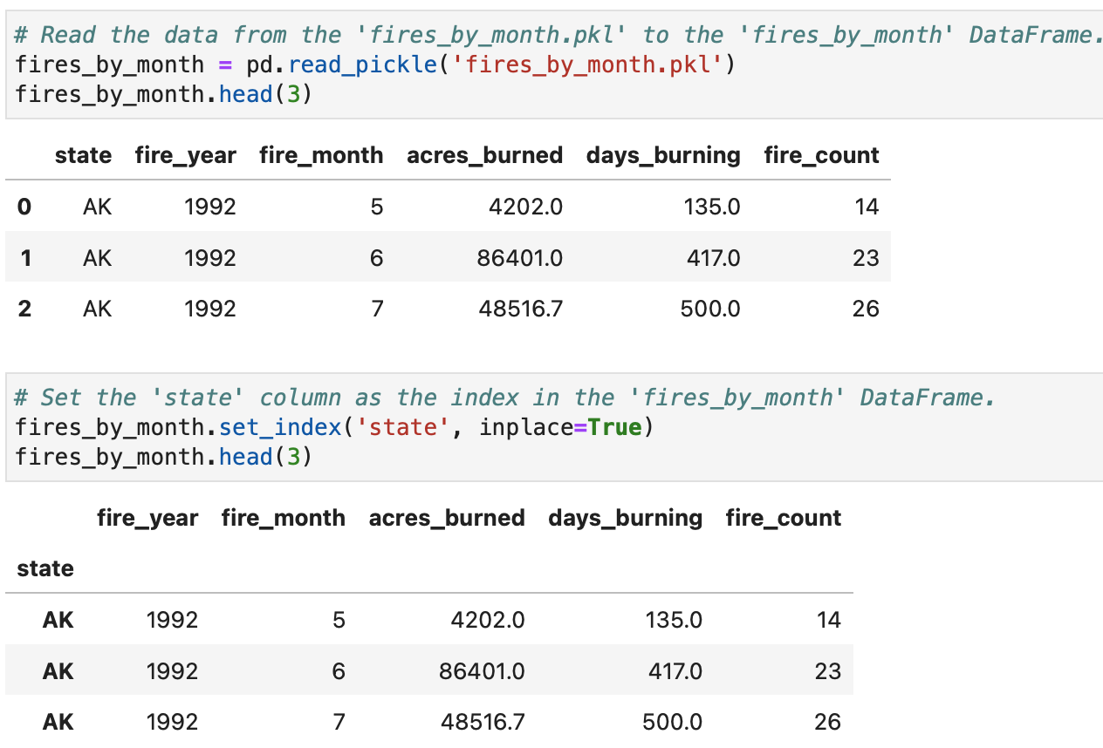
Setting a Column as the Index

Slide 22
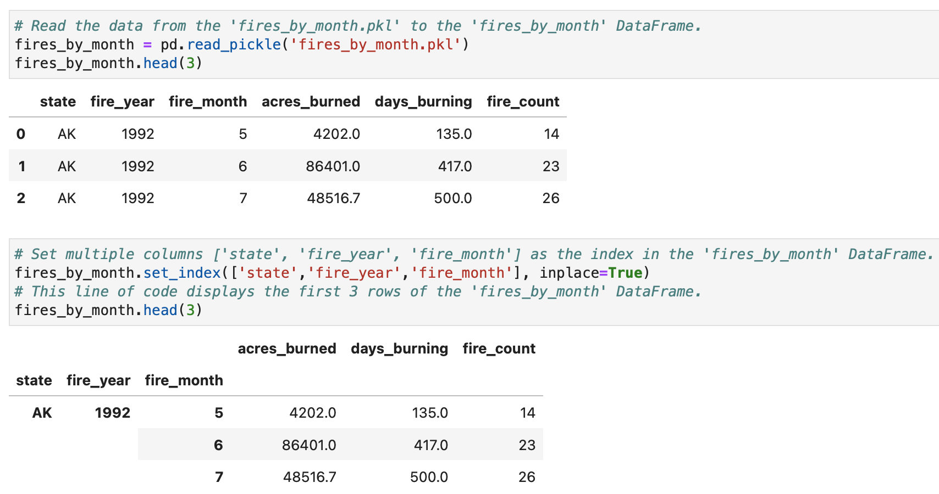
Setting Multiple Columns as the Index

Slide 23
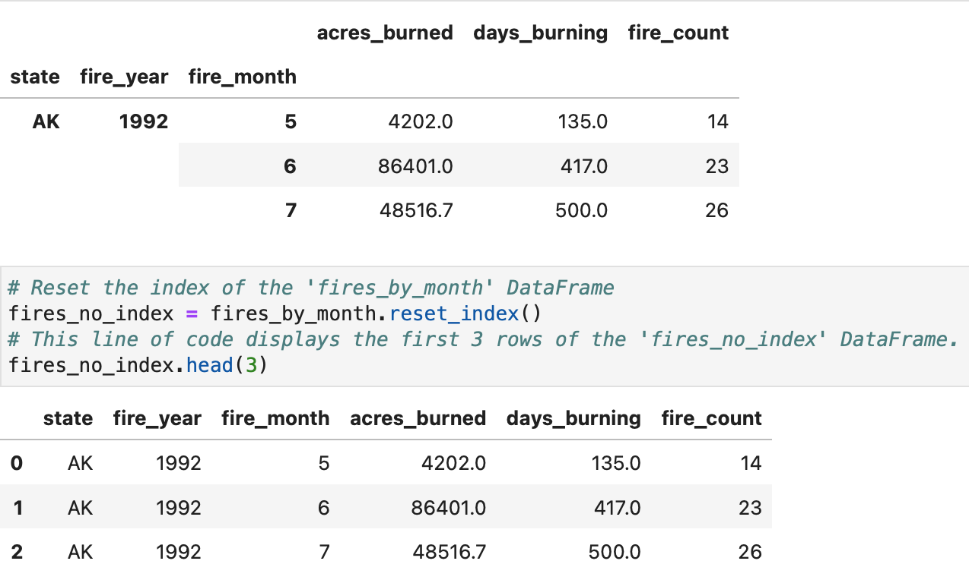
Resetting the Index

Slide 24
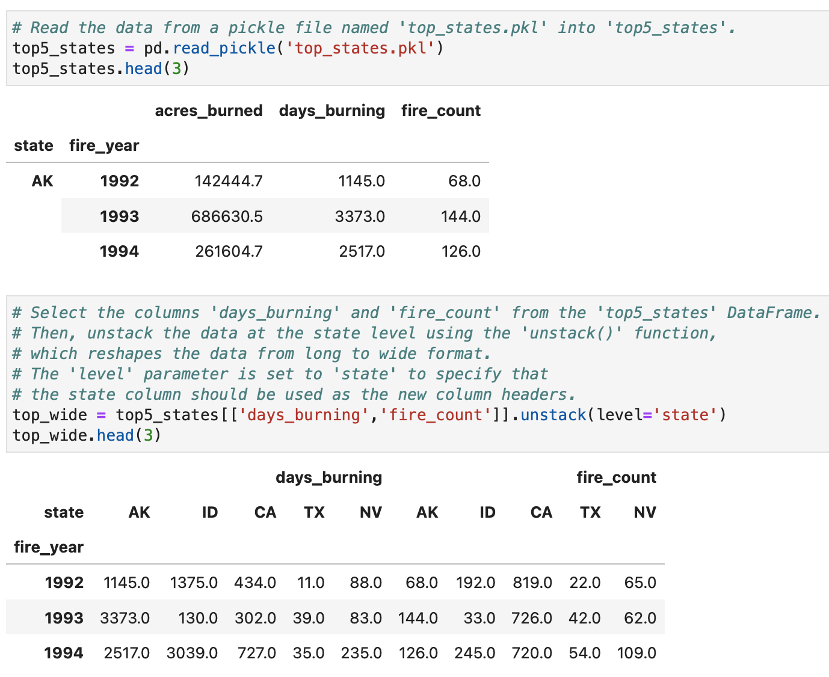
Unstacking Indexed Data

Slide 25
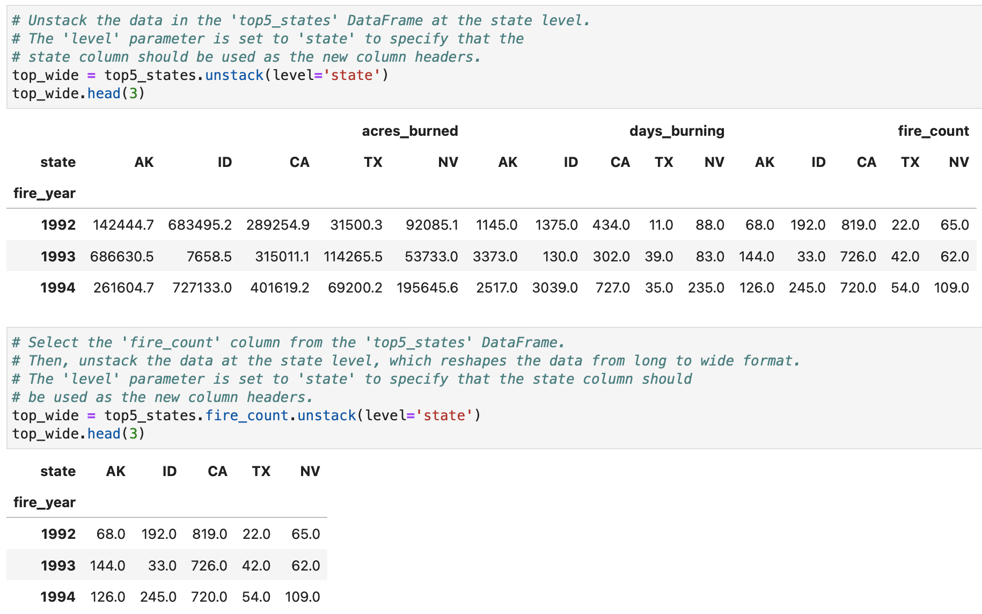
Unstacking Indexed Data (Cont.)

Slide 26
How to Combine DataFrames

Slide 27
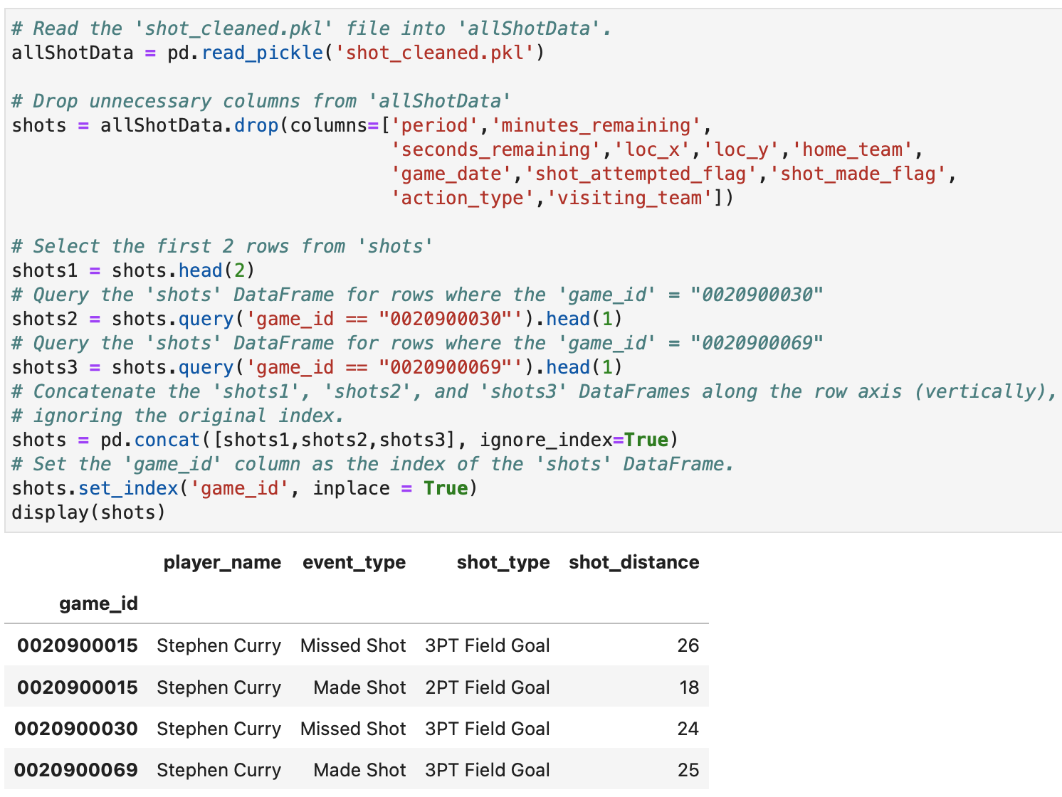
Concatenating DataFrames

Slide 28
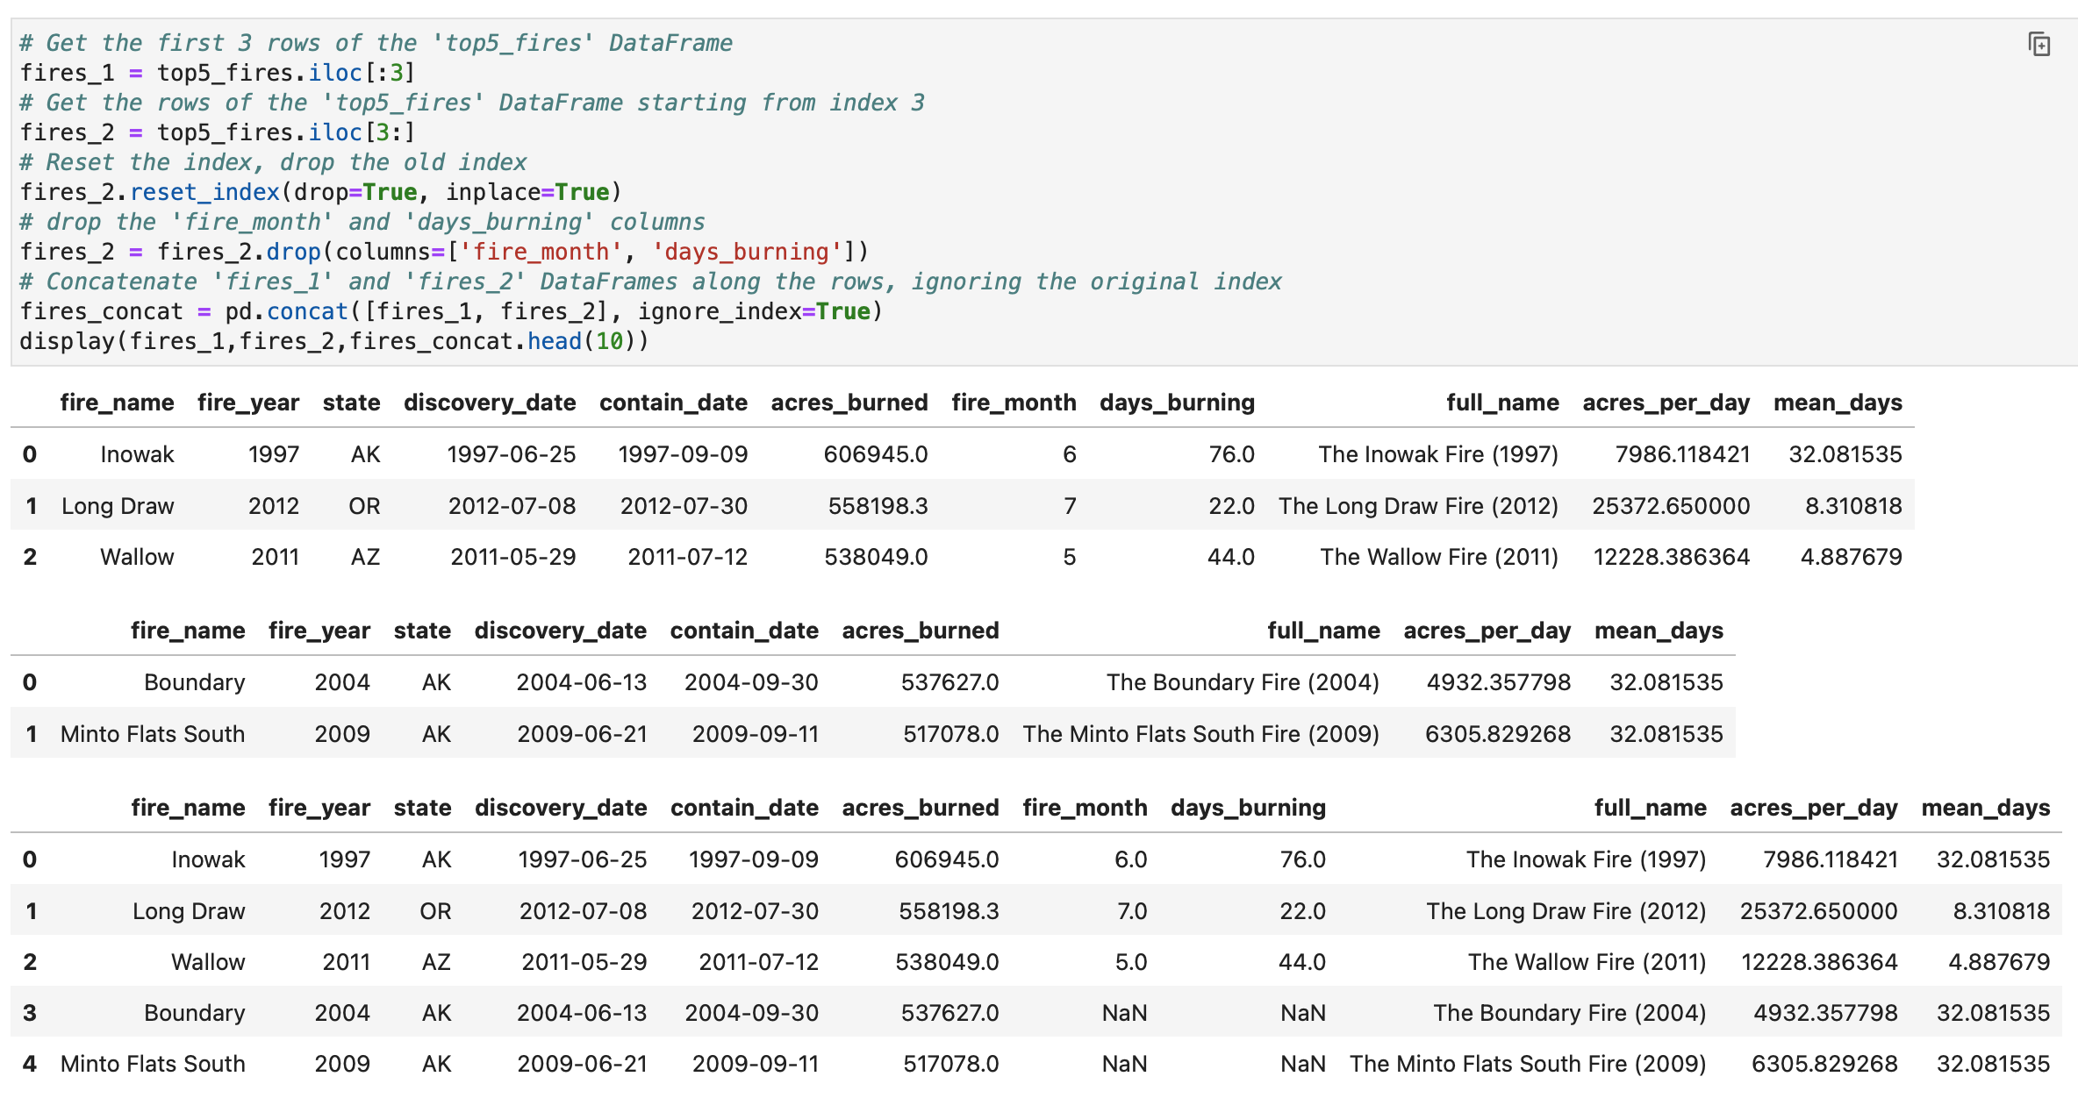
Concatenating
DataFrames

Slide 29
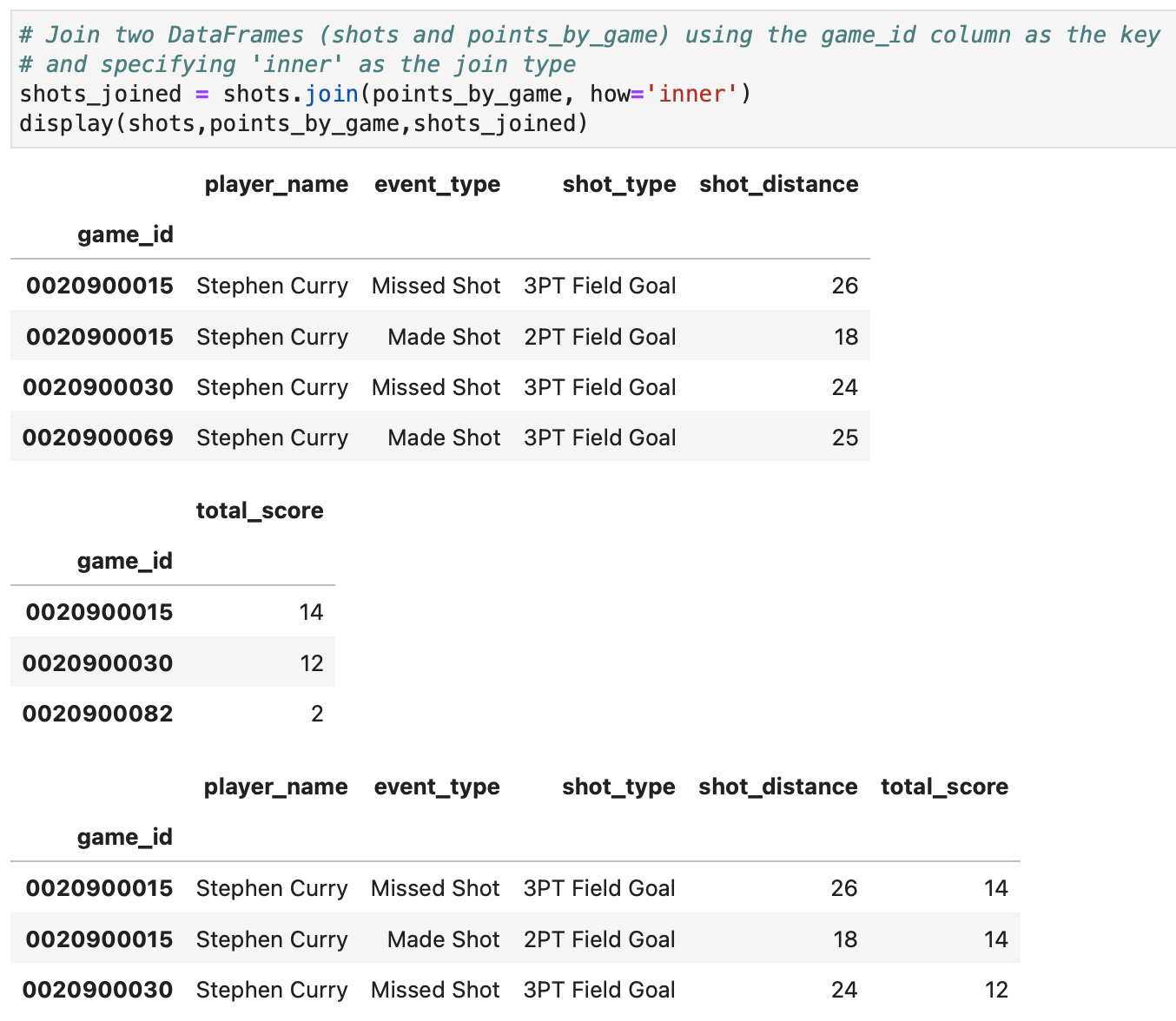
Inner-Join DataFrames

Slide 30
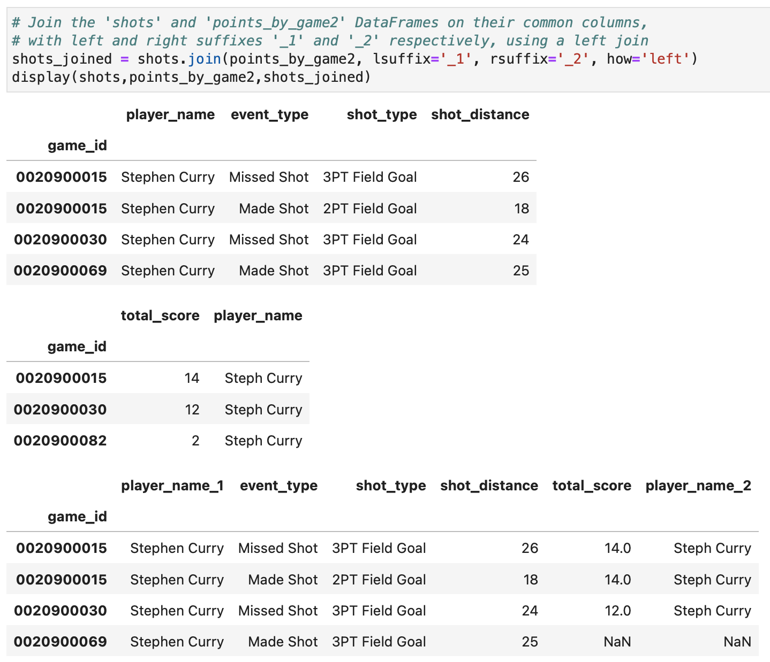
Left-Join DataFrames

Slide 31
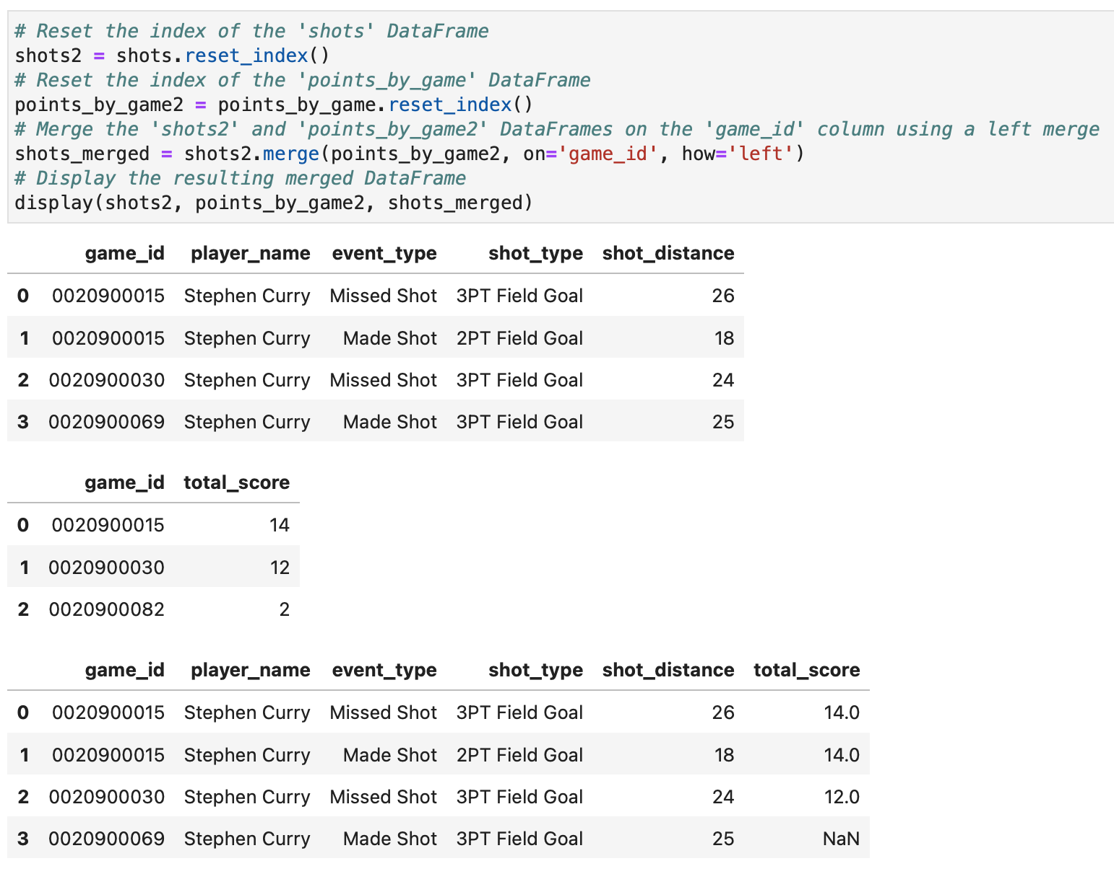
Left-Merge
DataFrames

Slide 32
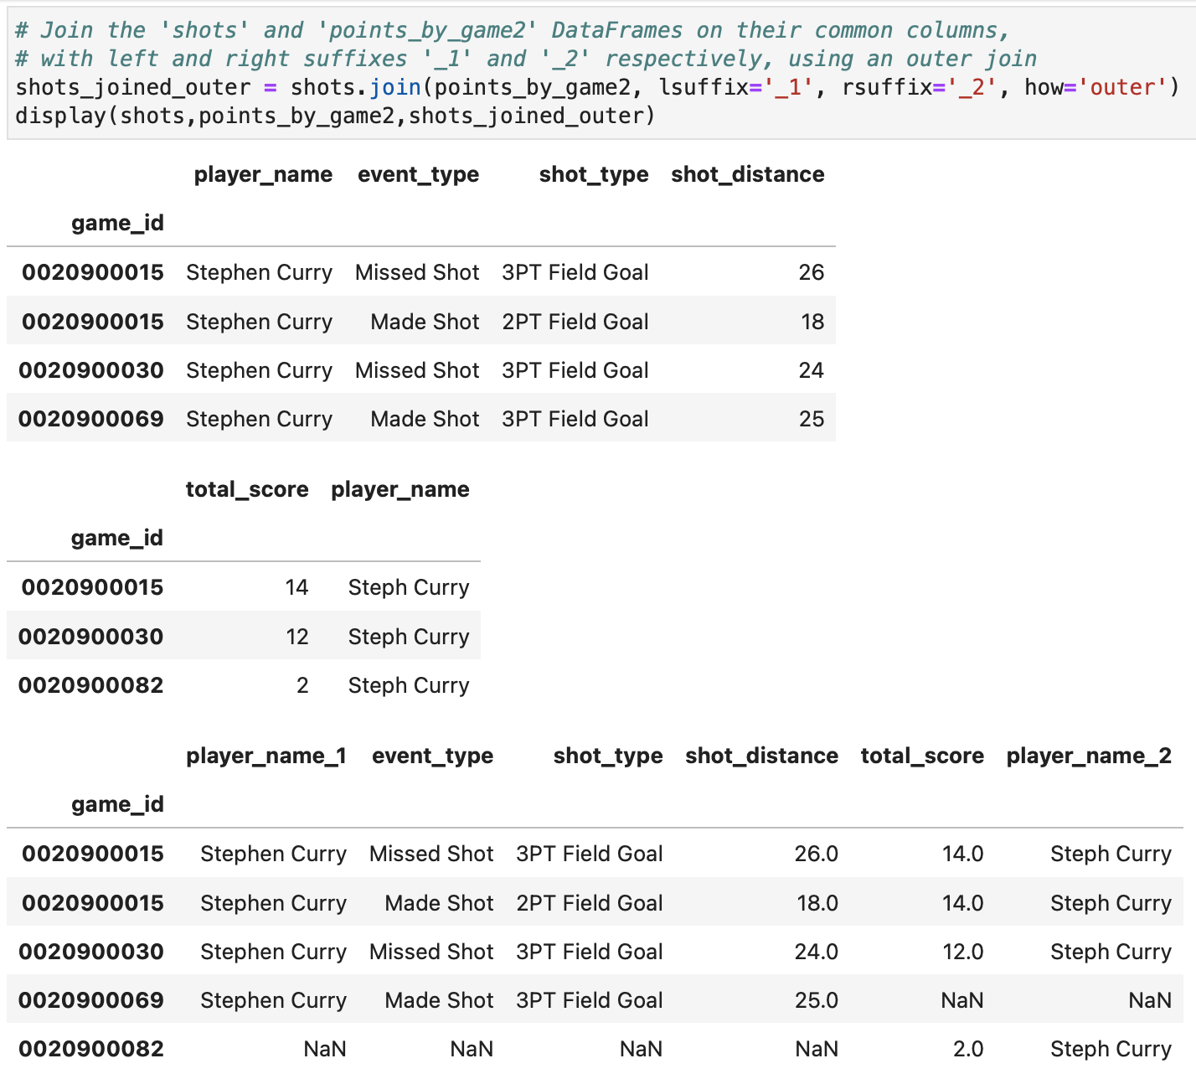
Outer-Join DataFrames

Slide 33
How to Handle the SettingWithCopyWarning

Slide 34
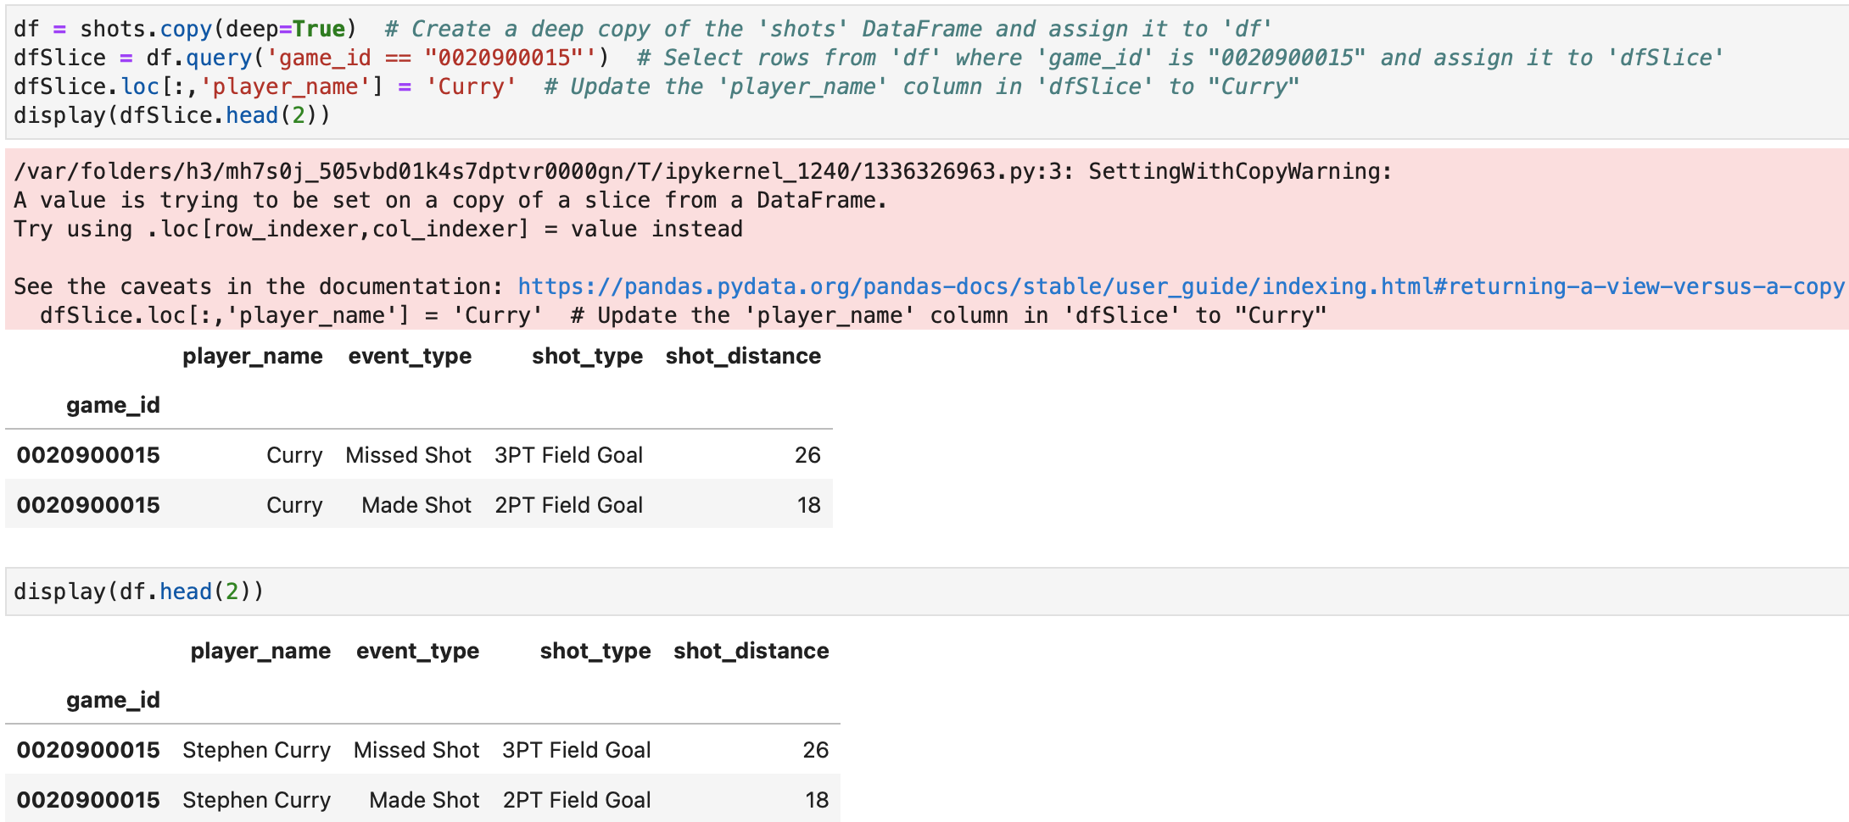
SettingWithCopyWarning; no Corruption
Notes:
Here we compare copies, slices, and references to show when changing one DataFrame unexpectedly changes another. Here, “data corruption” means an unintended change to the original DataFrame—not that the file becomes technically damaged.

Slide 35
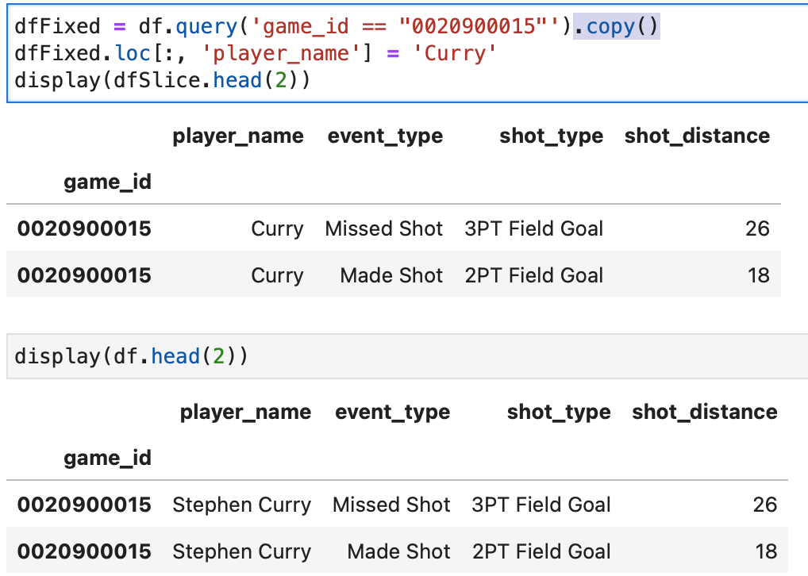
Fixing SettingWithCopyWarning; no Corruption
Notes:
This is correct when you want to modify a separate subset.

Slide 36
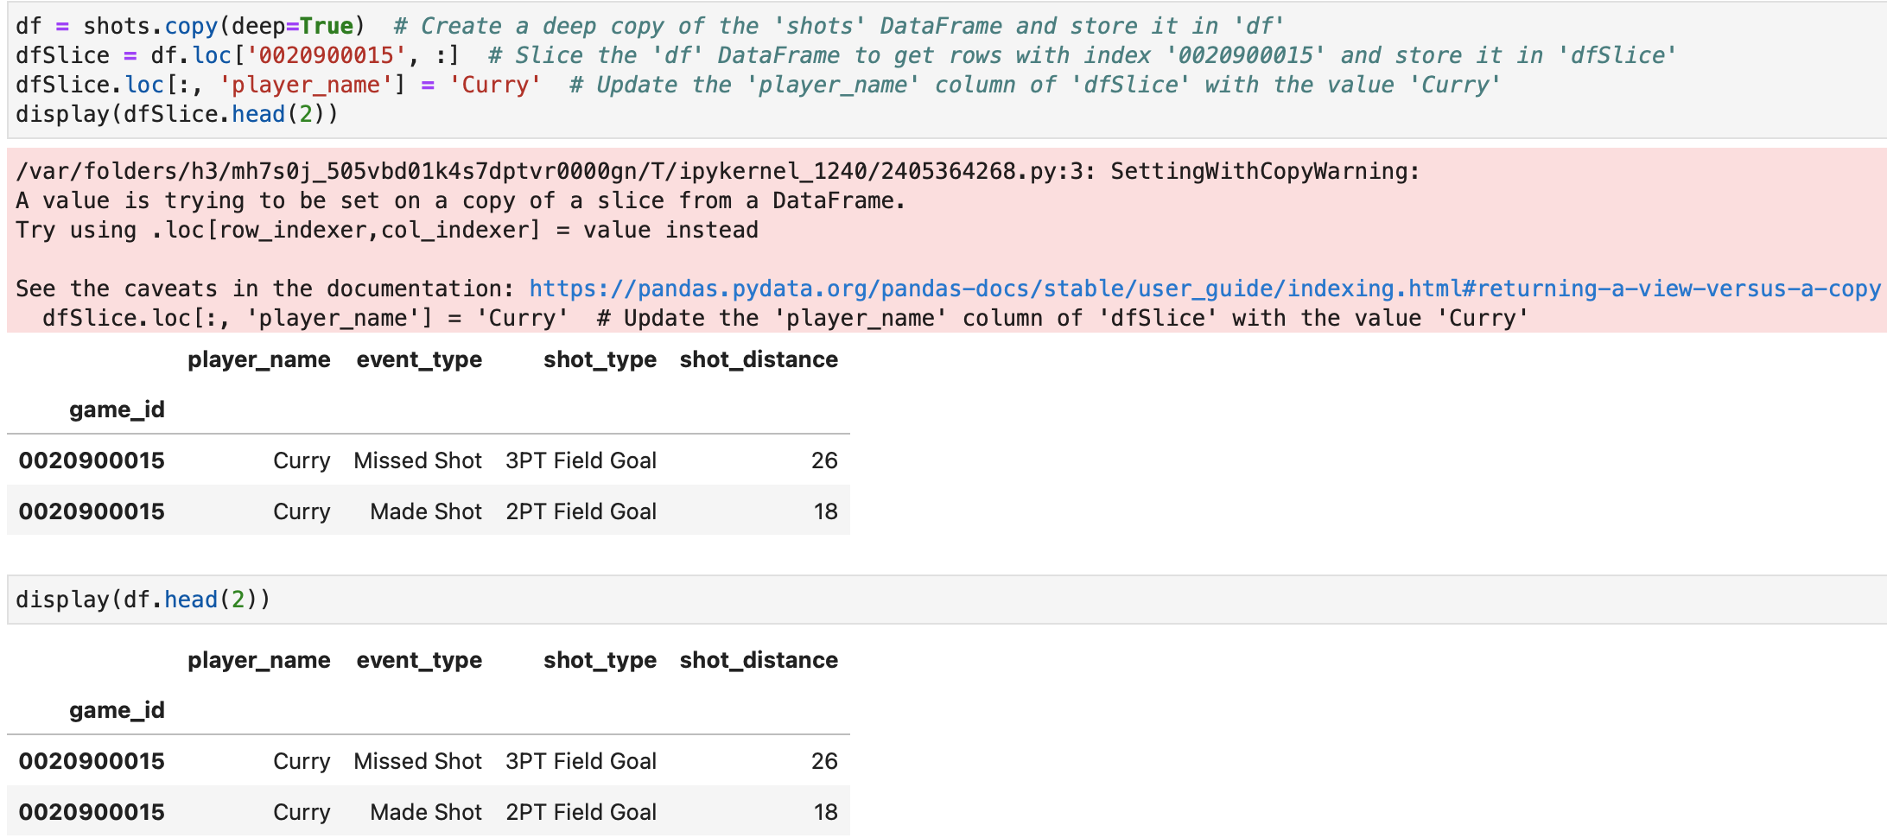
SettingWithCopyWarning; with Corruption

Slide 37
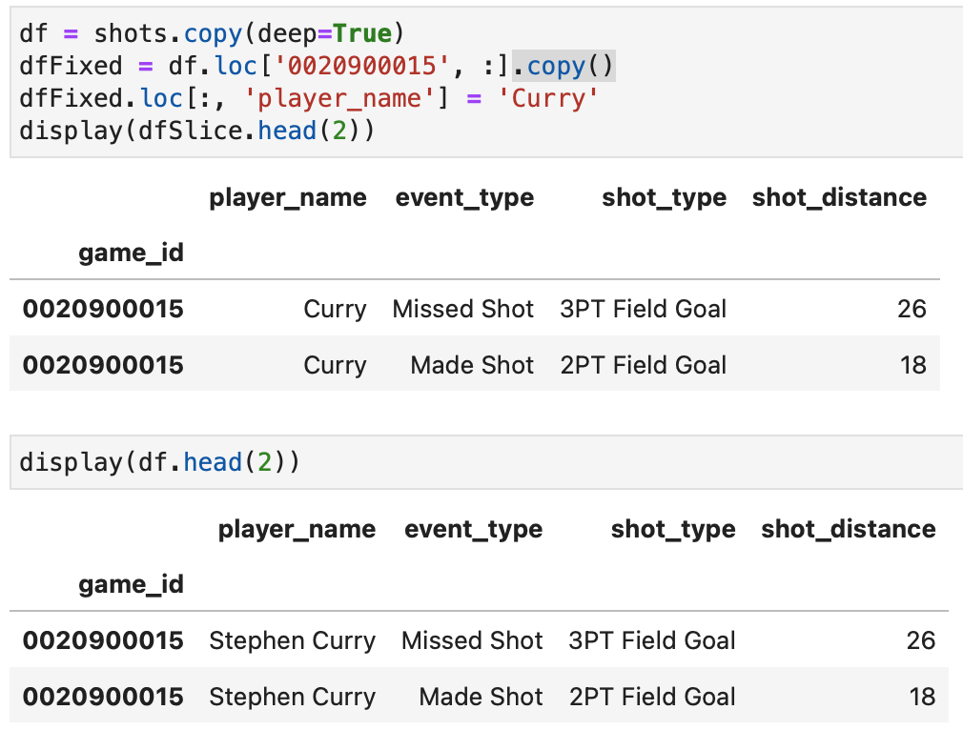
Fixing SettingWithCopyWarning; with Corruption

Slide 38
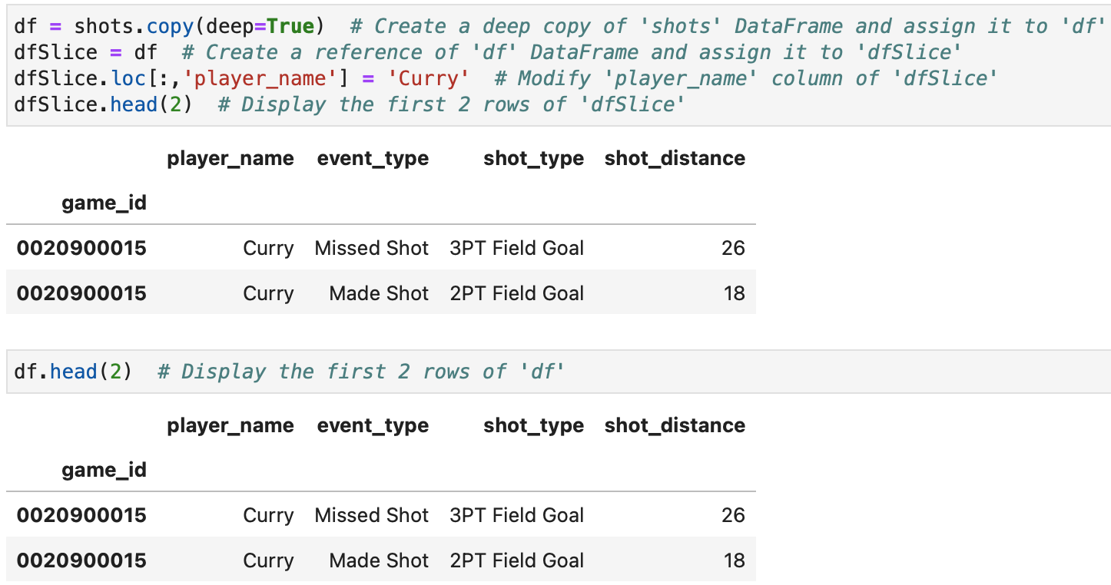
Data Corruption with no SettingWithCopyWarning

Slide 39
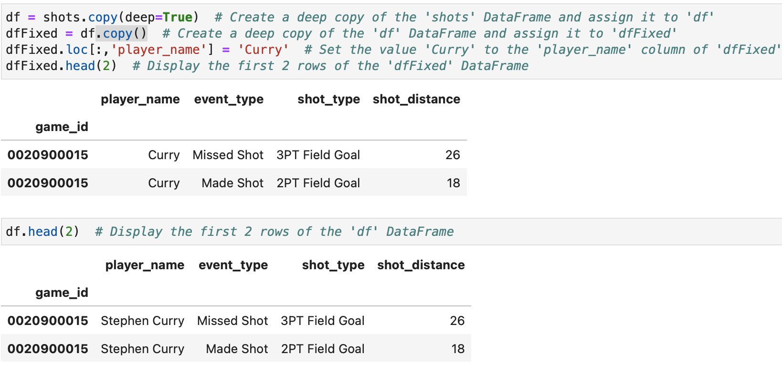
Fixing Data Corruption with no SettingWithCopyWarning

Slide 40
References
Data science from scratch: first principles with Python, Joel Grus, O'Reilly Media, 2019
Python for Data Analysis: Data Wrangling with Pandas, NumPy, and IPython, Wes McKinney, O'Reilly Media, 3rd edition, 2022.
Python Data Science Handbook: Essential Tools for Working with Data, Jake Vanderplas, O'Reilly Media, 2022
Murach’s Python for Data Analysis, Scott McCoy, Mike Murach & Associates, Incorporated, 2021.
Intro to Python for Computer Science and Data Science: Learning to Program with AI, Big Data and The Cloud, Paul Deitel, Pearson Education Limited, 2021.
ChatGPT

Slide 41

End of lecture …

